Slide 1
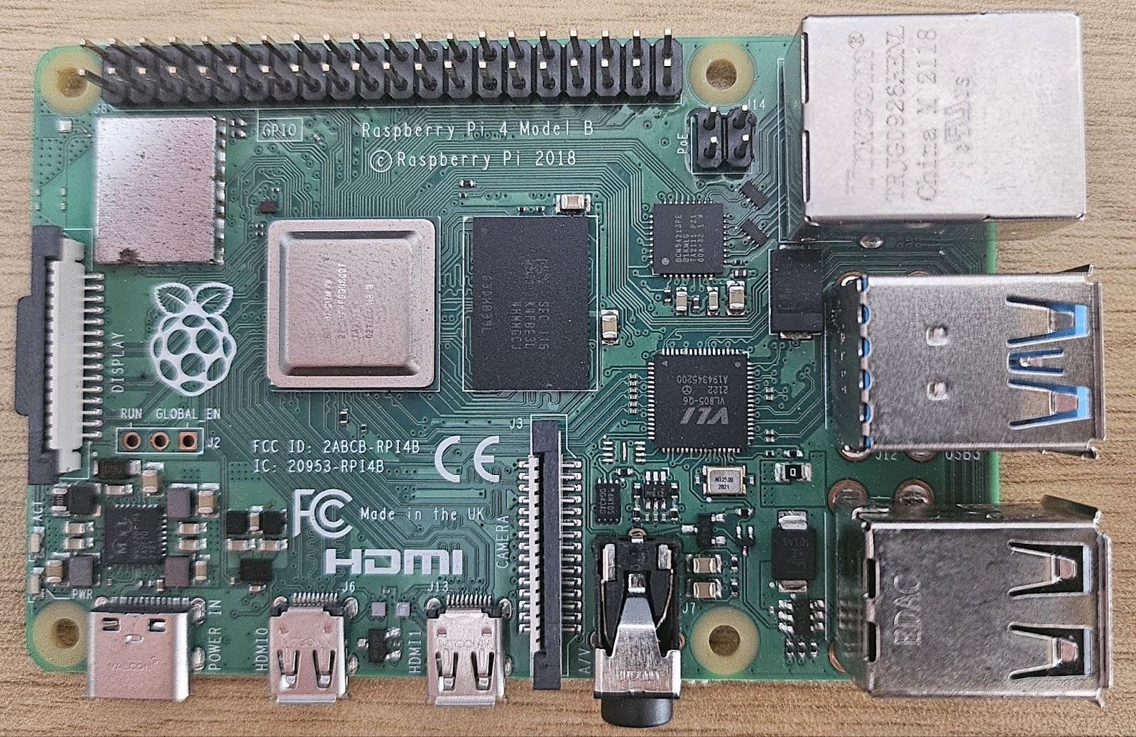
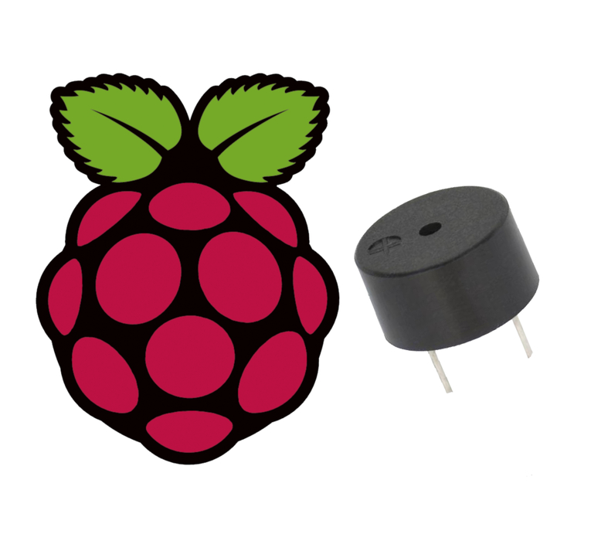


N
Wireless Buzzer Activation System
Powered by: • Raspberry Pi • User Datagram Protocol (UDP)
Technical highlights:
• Customizable alarm tones
• Remote Wi-Fi control
• Simple yet robust hardware design
• Instant alerts when seconds matter
b
[Source: instructables.com, How to Use a Buzzer]

Slide 2
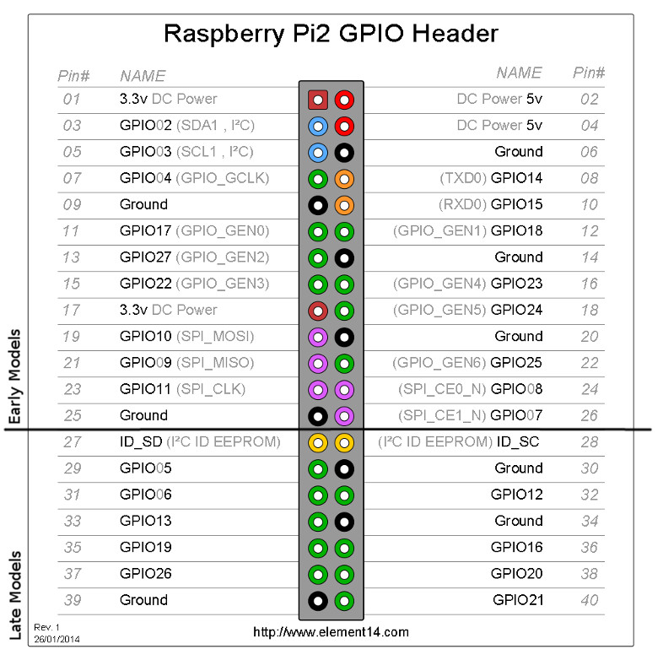
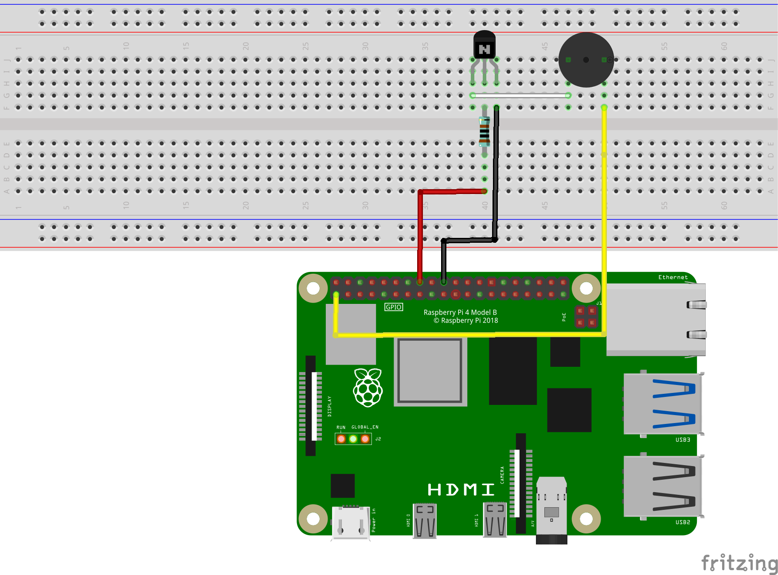
Hardware and Design
GPIO pin sends the PWM signal
1K Resistor protects the GPIO pin
NPN Transistor allows us to control the buzzer without a direct connection to the GPIO pin
Buzzer gets power from 3.3V pin on the Raspberry Pi
The frequency of the PWM signal will give the tone of the buzzer
[Source: learn.sparkfun.com, Raspberry GPIO]
Made with Fritzing

Slide 3
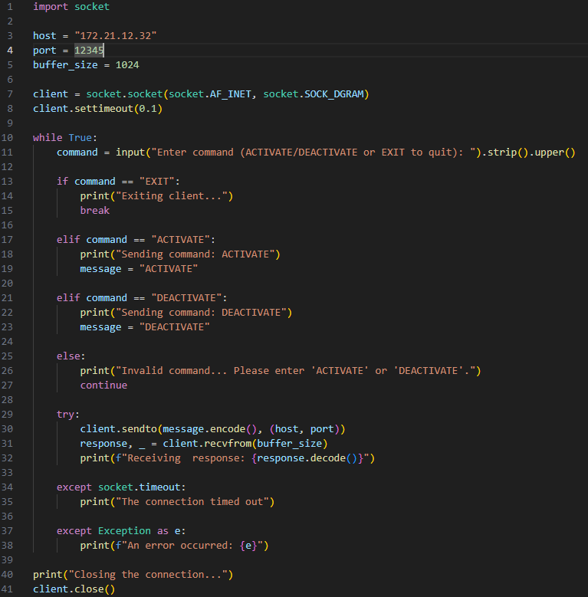
Python Client Code
Implementation
Socket setup
Instantiate host address, port number
set timeout for socket
Sock
User input acceptance loop
Uses conditional logic to process and send commands
Error handling:
Catches socket timeout error and other general errors

Slide 4
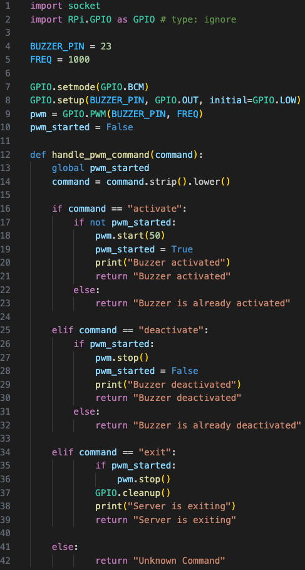
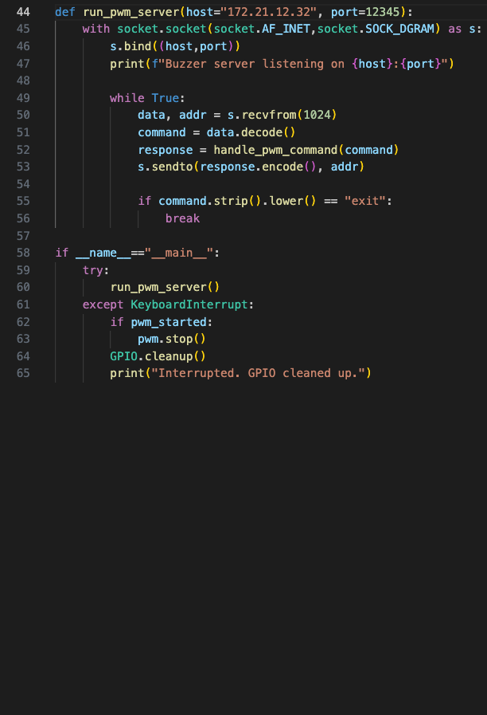
Python Server Code Implementation
GPIO Setup and Initialization
PWM Control Function
Function interprets command received from client
UDP Socket Server
Continuously listens for incoming messages
Seamless Exit Handling

Slide 5
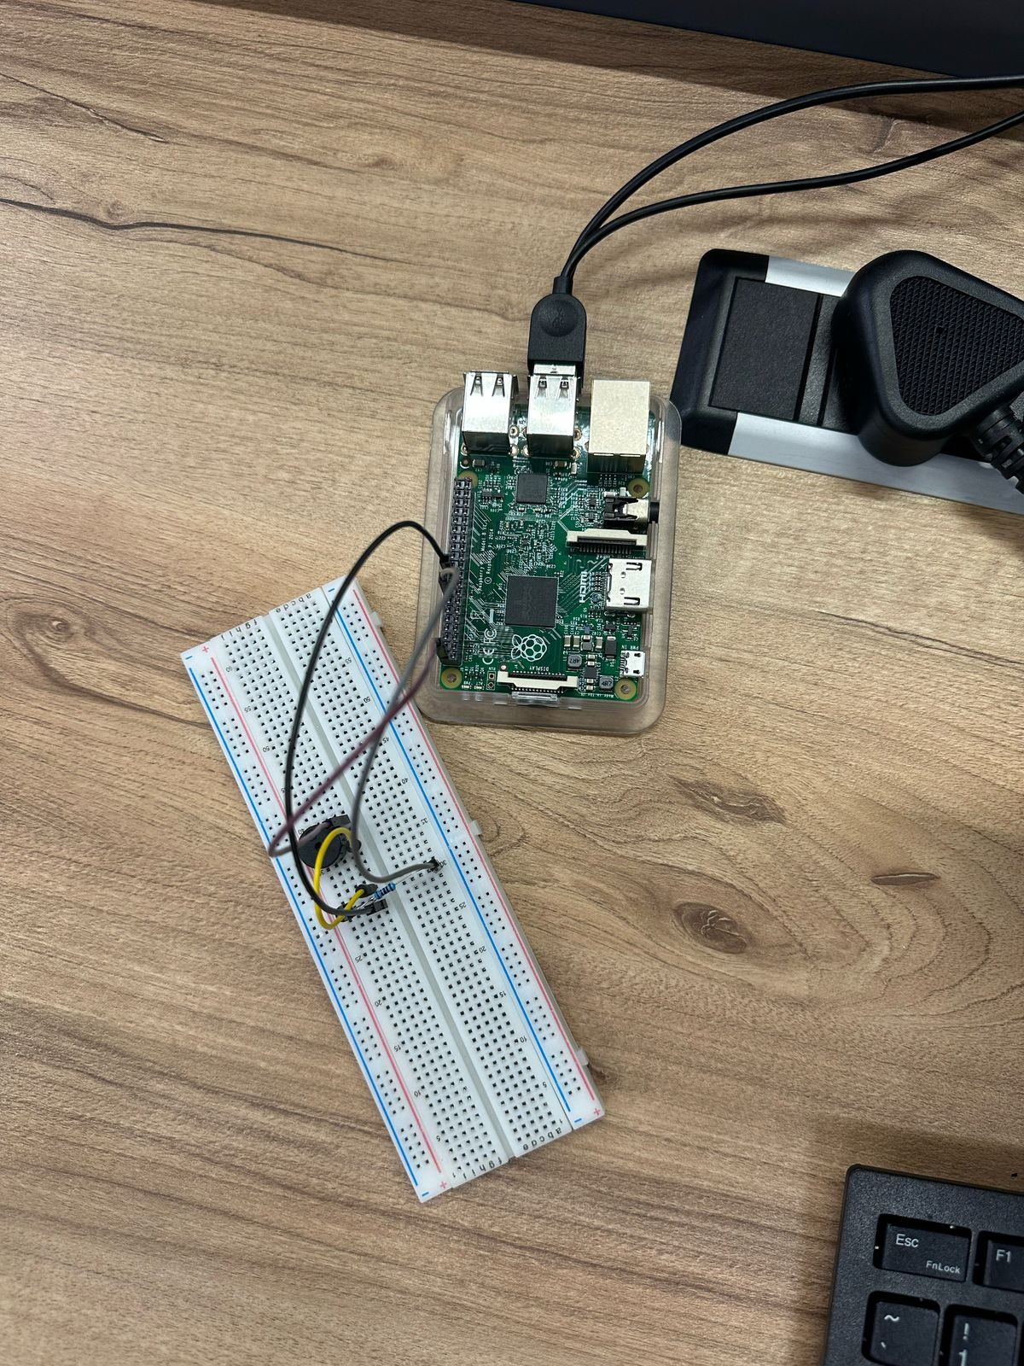
N
CONCLUSION
Demonstrates a reliable and low-cost solution for remote buzzer control
Utilizes the Raspberry Pi and UDP communication for efficient operation
Combines basic components with Python to make a practical IoT system
Designed to be adaptable and easy-to-implement
A solid introduction project to embedded systems and networked device communications
b

